Slide 1
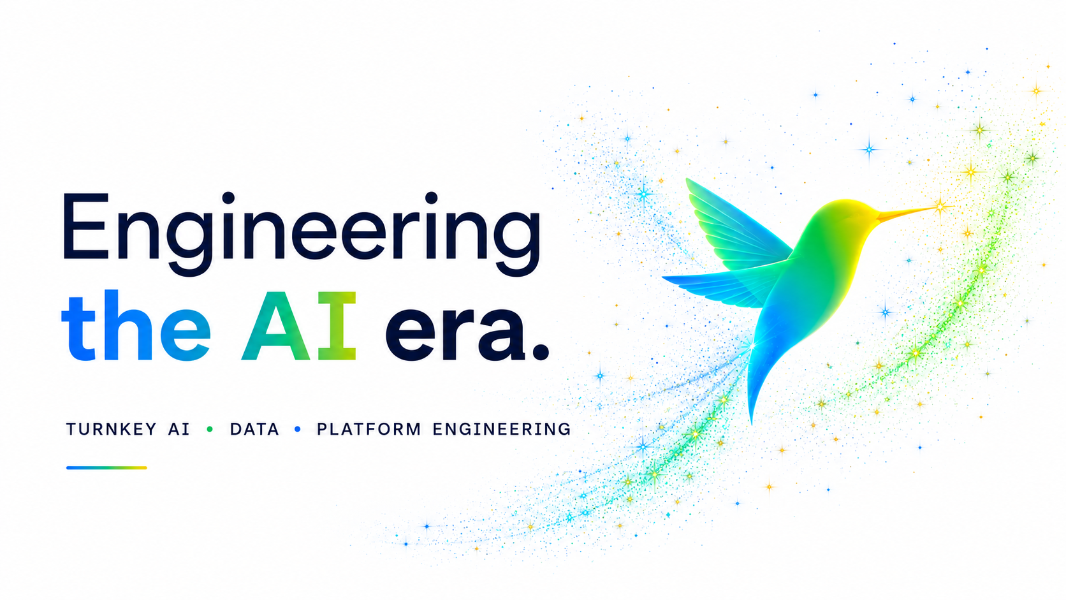

Slide 2
EXECUTIVE SUMMARY
Client Retention
96
%
Built on landed outcomes, not relationship management.
Built for
Evolving
Change
Projects Delivered
35+
Across several solution domains since founding.
Engineers
50+
Senior certified engineers averaging 7+ years.

Slide 3
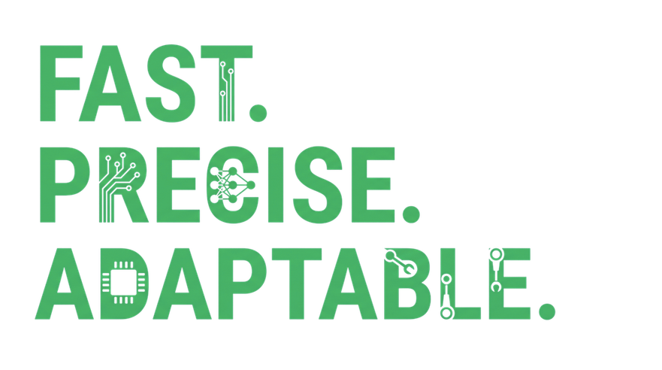
WHY NOW
Requirements evolve
Usage informs the next decision.
Quality is continuous
AI output can’t be tested only at the end.
Tech moves mid-build
New capabilities reshape solutions in flight.
Releases create data
Learning begins before release one.

Slide 4


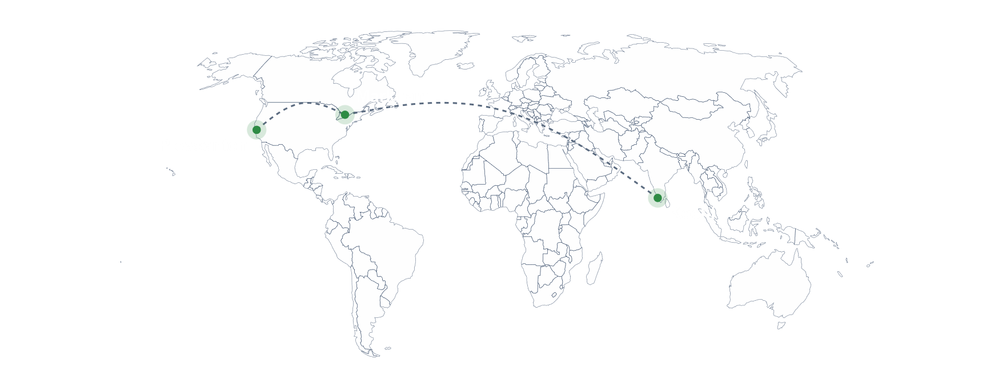

3
OUR JOURNEY
hubs.
One loop.
A 24-hour engineering loop across three time zones.
Headquarters
Nearshore
Pleasanton, CA
Nearshore
Delivery Center
Markham, ON
Markham, ON
Kochi, India
Client leadership and forward-deployed engineers.
Same-time-zone engineering, deep US collaboration.
Same-time-zone engineering, deep US collaboration.
Infopark campus powering the overnight loop.

Slide 5
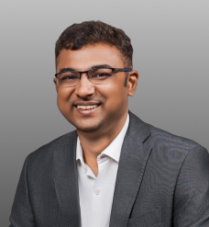
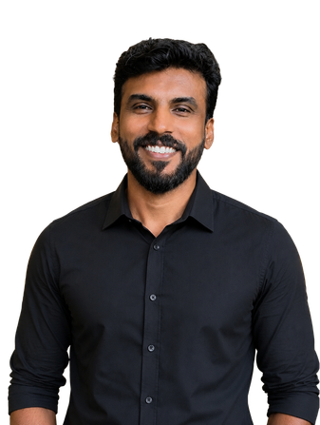


THE TEAM
Leadership with over 2 decades of Tech experience
CEO, Co-Founder
CTO
Balesh Lakshminarayanan
Ajish Cherian
Technology entrepreneur and Times 40 Under 40 awardee. Former founder-CEO of a consulting firm he successfully scaled and exited.
Technology leader focused on scalable cloud, data and generative AI solutions. Work spans AI systems, platform engineering and digital transformation.
VP, Operations
Advisor
Anjana Gopakumar
Bijoy Jose
Media & technology leader with past roles at Netflix, Snapchat and Nielsen. Expertise driving operations at the intersection of technology and AI.
Principal consultant of Abilytics. PhD in Computer Engineering from Virginia Tech; former Software Architect at Intel Corporation.

Slide 6
Our Values

Slide 7
Our Delivery Model:
Agile + Loop Engineering
Think in outcomes. Build in loops. Learn continuously.
Usage data and operating evidence feed the next loop - the release is where learning begins.

Slide 8
Why the Next Decade Belongs to AI-Native Engineering Companies

Slide 9
WHAT WE DO
Four
practices.
One
partner.
AI Systems
Data Engineering
AI strategy & roadmaps
Model selection & fine-tuning
Enterprise AI & agentic systems
Analytics & insights
Pipelines, lakehouse & DataOps
Streaming & data quality
Platform Engineering
Product Engineering
Internal developer platforms
Kubernetes, CI/CD & IaC
Observability & security
AI-native product build
MVP to scale, full stack
UX, design & iteration

Slide 10
Our Technology Expertise
The stack behind the outcomes. Cloud-neutral by design.

Slide 11
Product Capability
ABILYTICS STUDIO INCIDENT MANAGEMENT PLATFORM
AI-driven platform that predicts, accelerates, and automates incident resolution.
  85% Faster Root Cause Identification driven platform that predicts, accelerates, and automates incident resolution.
  60% Reduction in Mean Time to Resolution (MTTR)

Slide 12
MEASURABLE OUTCOMES
Numbers, not narratives.
$500K
75
14
80
Connect
%
WKS
%
PROJECT DELIVERED AT 1/10TH COST
FASTER DEVELOPMENT
Avg TURNKEY AI DELIVERY
LOWER DEVELOPMENT COST
SEAMLESS INTEGRATION
Enterprise-grade AI solution at a fraction of traditional build cost.
Accelerated delivery through reusable AI components and automation.
End-to-end from discovery to production-ready deployment.
Proven frameworks that eliminate redundant engineering spend.
Integrate data with any tech stack or hardware incl. wearables.

Slide 13


ECOSYSTEM
Partnerships that compound speed
Trusted by engineering teams at
Product Director,
Verified client
VP of Engineering,
Verified client
“The speed and quality of delivery are unmatched. They didn't just write code; they partnered with us to solve our core business challenges.”
“Working with them was a game-changer. The AI orchestration workflow they built allowed us to automate hundreds of hours of manual data entry each week.”

Slide 14
Let's build your first loop.
50+
35+
70+
letsconnect@abilytics.com
EMPLOYEES
PROJECTS
CERTIFICATIONS
Pleasanton, CA · Markham, ON · Kochi, India

Slide 15

Proof
in action
CASE STUDIES · ENGAGEMENTS ACROSS DIFFERENT SOLUTION DOMAINS

Slide 16
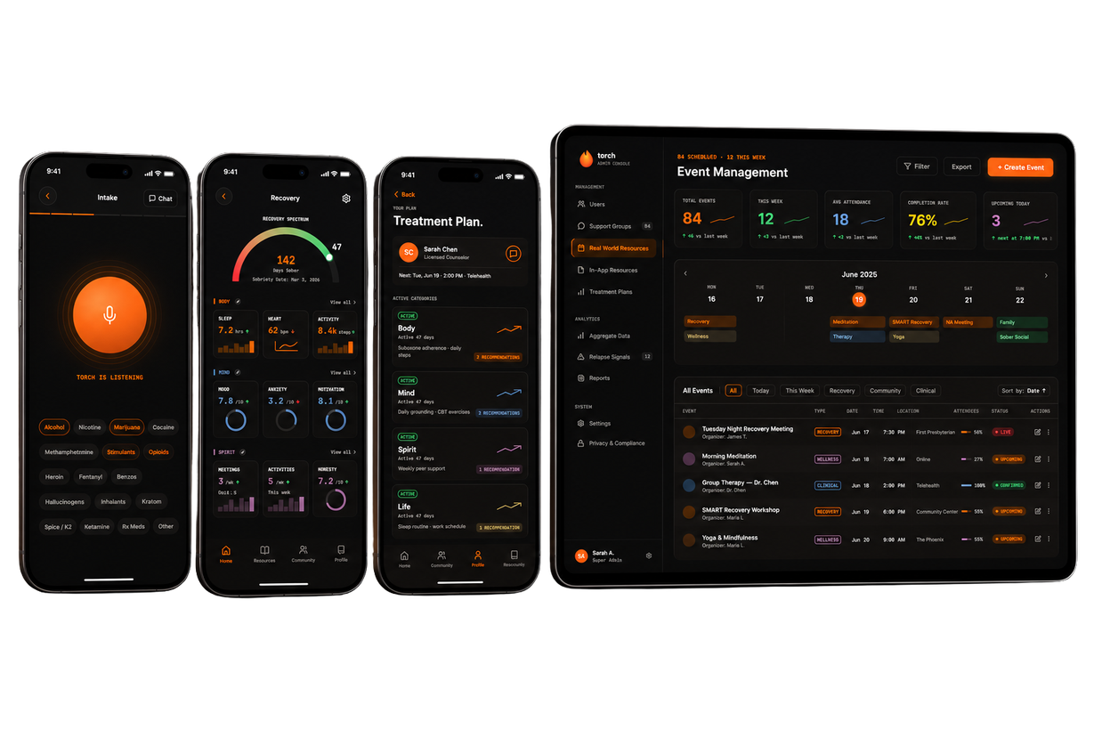
CASE STUDIES · PRODUCT ENGINEERING & EDGE AI
Accelerating intelligent products at the edge.
PRODUCT ENGINEERING · AI WELLNESS PLATFORM - UNITED STATES
Building an AI-powered recovery companion for everyday resilience
Designed and developed Torch, a recovery platform that combines conversational AI and habit tracking to help users build healthier routines.
OUTCOME
• Project delivered at 1/10th the original cost.
• Accelerated development speed by 20x.
• Delivered in less than 4 months with turnkey AI solutions.
• Seamless integration with hardware, incl. wearables.

Slide 17
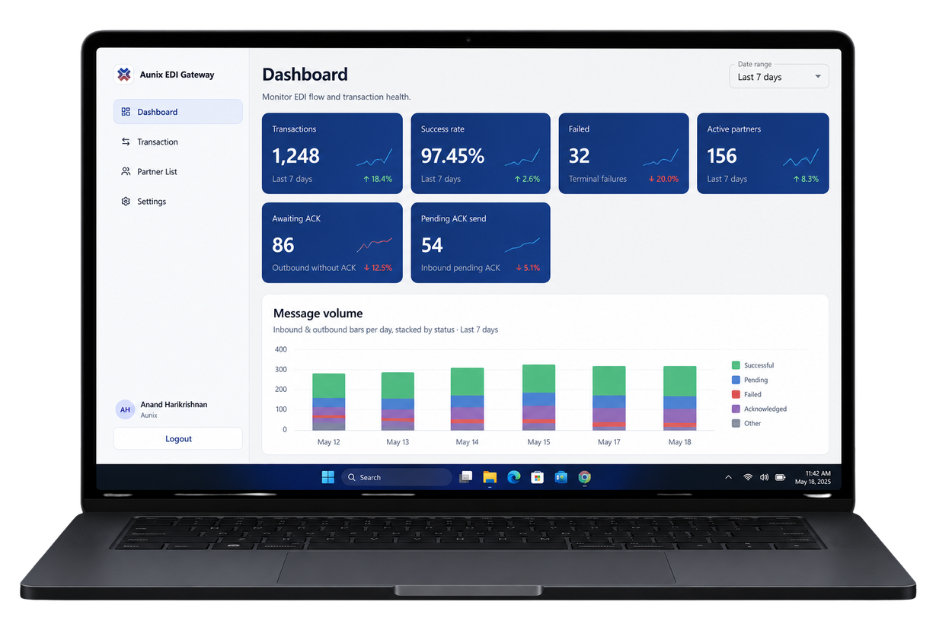
CASE STUDIES · PRODUCT ENGINEERING & EDGE AI
Aunix EDI Gateway
PRODUCT ENGINEERING · ENTERPRISE INTEGRATION PLATFORM – INDIA
Accelerating secure B2B document exchange at enterprise scale
Built Aunix EDI Gateway, a modern enterprise integration platform that automates Electronic Data Interchange workflows, providing organizations with secure document exchange, transaction monitoring, partner management, acknowledgment tracking, and actionable operational insights through an intuitive dashboard.
OUTCOME
• 20x faster partner onboarding.
• Reduced manual EDI processing by 40%
• Improved transaction visibility with real-time monitoring.

Slide 18
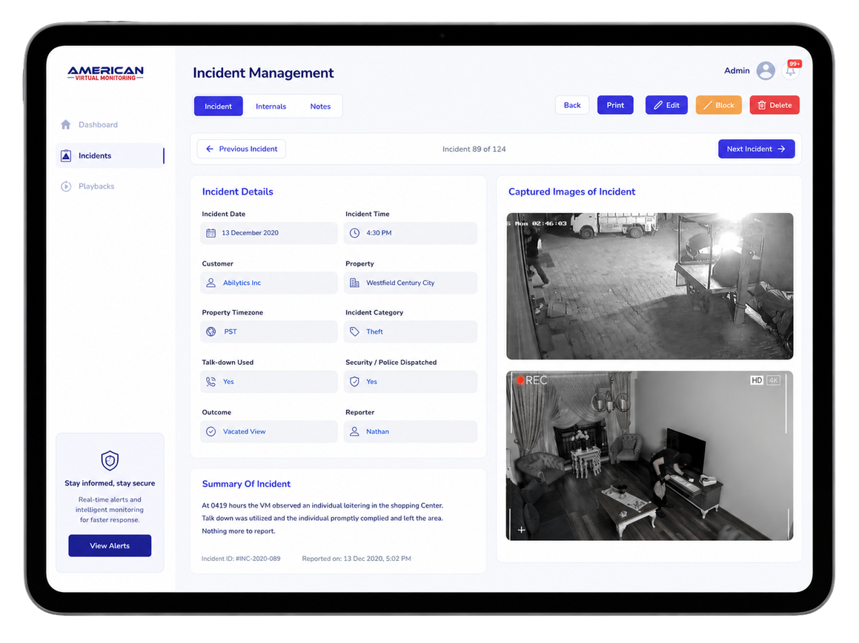
CASE STUDIES · PRODUCT ENGINEERING & EDGE AI
AVM – Incident Management
PRODUCT ENGINEERING · SECURITY OPERATIONS PLATFORM – UNITED STATES
Transforming security operations with intelligent incident workflows
Built a modern Incident Management platform that streamlines security event documentation, evidence capture, operator collaboration, and reporting—helping monitoring teams respond faster while maintaining complete audit trails across every incident.
OUTCOME
• 30x reduction in incident processing time.
• Faster evidence review with centralized image management.
.Enhanced visibility into incident lifecycle and resolution.

Slide 19
CASE STUDIES · DATA BRICKS
Enterprise Databricks Solutions Built for AI-Ready Data Platforms.
PHARMA EDI · INDIA
DSCSA TRACEABILITY TECH STARTUP · INDIA
Complex EDI Integration
Fragmented Supply Chain Visibility
Legacy X12/EDIFACT files are difficult to interpret, with every trading partner using different specifications.
Supply chain and traceability data is scattered across partner systems, and middleware, making it difficult to gain real-time insights, ensure DSCSA compliance.
OUTCOME
OUTCOME
    11 trading partner data sources unified into a single Databricks Lakehouse, eliminating fragmented EDI processes.
· 100% end-to-end lot-level traceability.
    Real-time supply chain visibility powered by Spark SQL, Lakebase, and Databricks Genie.
    100% of EDI transactions transformed into AI-queryable Delta Lake tables.

Slide 20
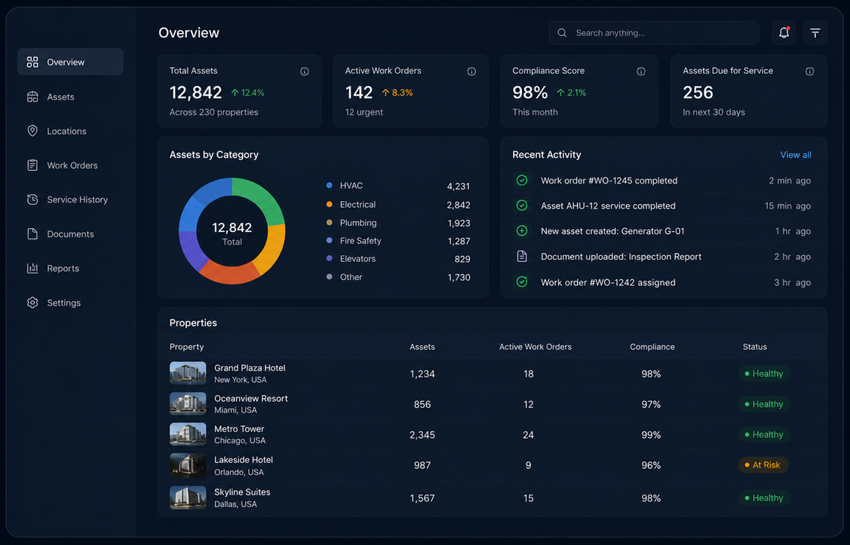
CASE STUDIES · INTELLIGENT ASSET MANAGEMENT
Every asset tracked, documented and searchable
MULTI-PROPERTY ENTERPRISES · GLOBAL
Asset lifecycle management with AI-powered search
Automated asset creation and documentation with centralized service history and instant AI search.
OUTCOME
· Faster asset onboarding.
· Instant access to docs and history.
· Improved compliance posture.

Slide 21

CASE STUDIES · COMPUTER VISION & EDGE AI
Eyes that never blink, at the edge
AI FURNISHING INNOVATOR · INDIA
AI object detection for commercial furnishing
Object detection and attribute recognition driving personalized product matching.
OUTCOME
· Simplified product discovery.
· Personalized recommendations at scale.

Slide 22
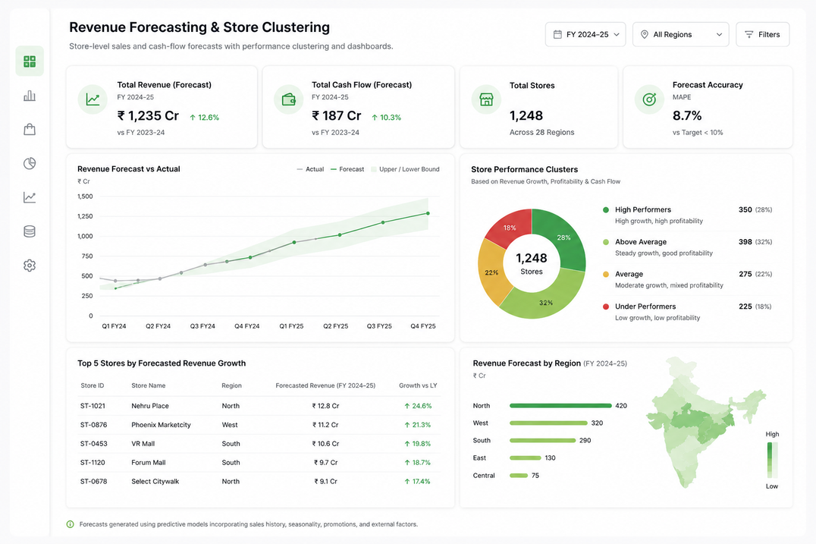
CASE STUDIES · PREDICTIVE ANALYTICS
Forecasts that cut waste and fund growth
LEADING TIRE DISTRIBUTOR · INDIA
ML project for sales forecasting
Store-level sales and cash-flow forecasts with performance clustering and dashboards.
OUTCOME
· Sharper financial planning.
· High and under-performers identified.
· Data-driven quarterly strategy.

Slide 23
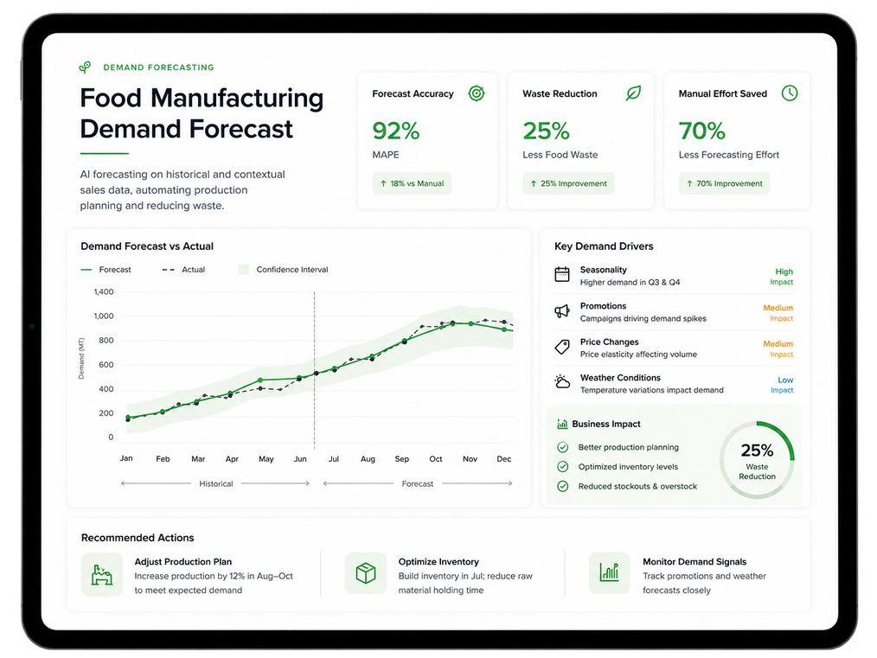
CASE STUDIES · PREDICTIVE ANALYTICS
Forecasts that cut waste and fund growth
FOOD & BEVERAGE MANUFACTURER · INDIA
Demand forecasting for food manufacturing
AI forecasting on historical and contextual sales data, automating production planning.
OUTCOME
· 25% less food waste.
· 70% less manual forecasting effort.
· Better inventory turnover.

Slide 24
CONTACT US
Building the next
chapter of Data & AI
Phone
Website
E-mail
(341) 237-2531
abilytics.com
letsconnect@abilytics.com

